Slide 1

Statistical Analysis of Hotel booking demand
By:
Carlos Daniel Leonardo Marcelo

Slide 2

Motivation & Summary
Perform an Exploratory Data Analysis (EDA) of two different hotels. (city and beach)
Cancelations are the main revenue leakage in the propriety management Find correlations between Cancelation and various factors.
Create Action Plans to reduce cancelations

Slide 3

Questions & Data
Where do the guests come from?
Which month have the highest number of cancelations?
How does the price per night vary over the year?
Bookings by market segment
Which are the busiest month?

Slide 4

Data Cleanup & Exploration
Our cleaning process
Problems experienced
Set Goals and Create a Plan

Slide 5
Graphs

Slide 6
Data analysis

Slide 7
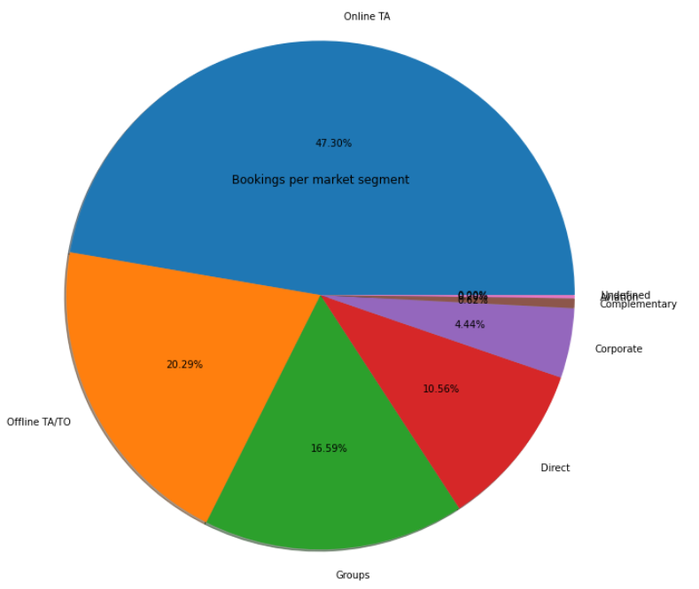
Bookings by market segment
47.30% of bookings were made online, 20.29% offline
The rest were made by groups, corporations, directly at the hotel or by airline packages

Slide 8
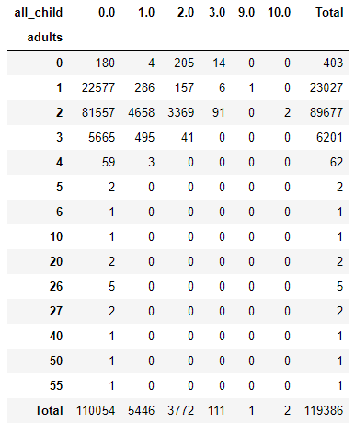
Bookings by market segment
From this table we can deduce that of the 119,000 reservations, 110,054 were reservations for without children, most of them couples, followed by clients traveling alone.
When there are more bookings with children, two adults travel, we can deduce that they are couples and their children

Slide 9
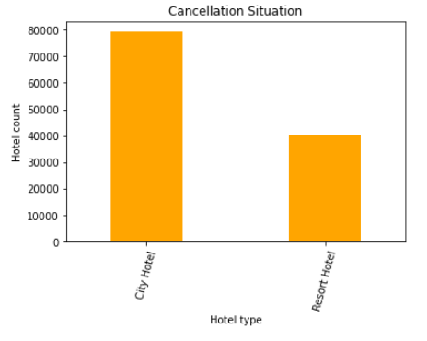
Cancelations
37,04% of total bookings were canceled

Slide 10
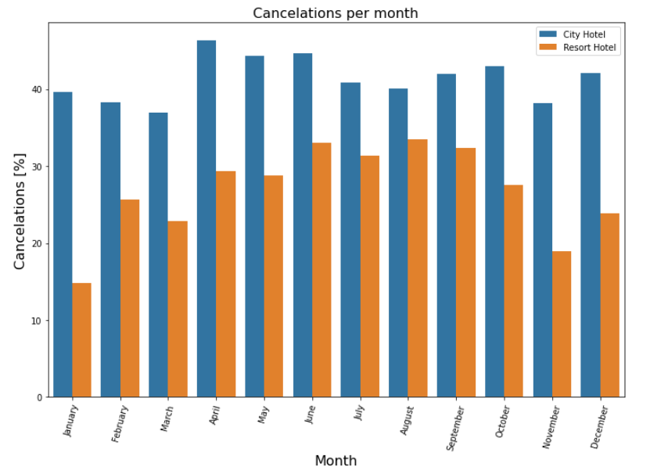
Cancelations per month
August is the month with more cancelations and January is the month with less cancelations
For city hotels there is not much variance between months
For the Resort hotel it is highest cancelations in the summer and lowest during the winter

Slide 11



Make a Plan
Set a destination and/or travel theme
1
Set travel dates, mode of travel, and find accommodations
2
Find local attractions, food venues, and activities
3

Slide 12

Any Questions?
Thank you

